Slide 1


Korea-Maryland, USA
Bio Expo 2013
The Bio Road Across the World
Expo Guide
November 6th – 9th, 2013
The Universities at Shady Grove Conference Center
9630 Gudelsky Dr., Rockville, MD
JG Business Link International, Inc.

Slide 2
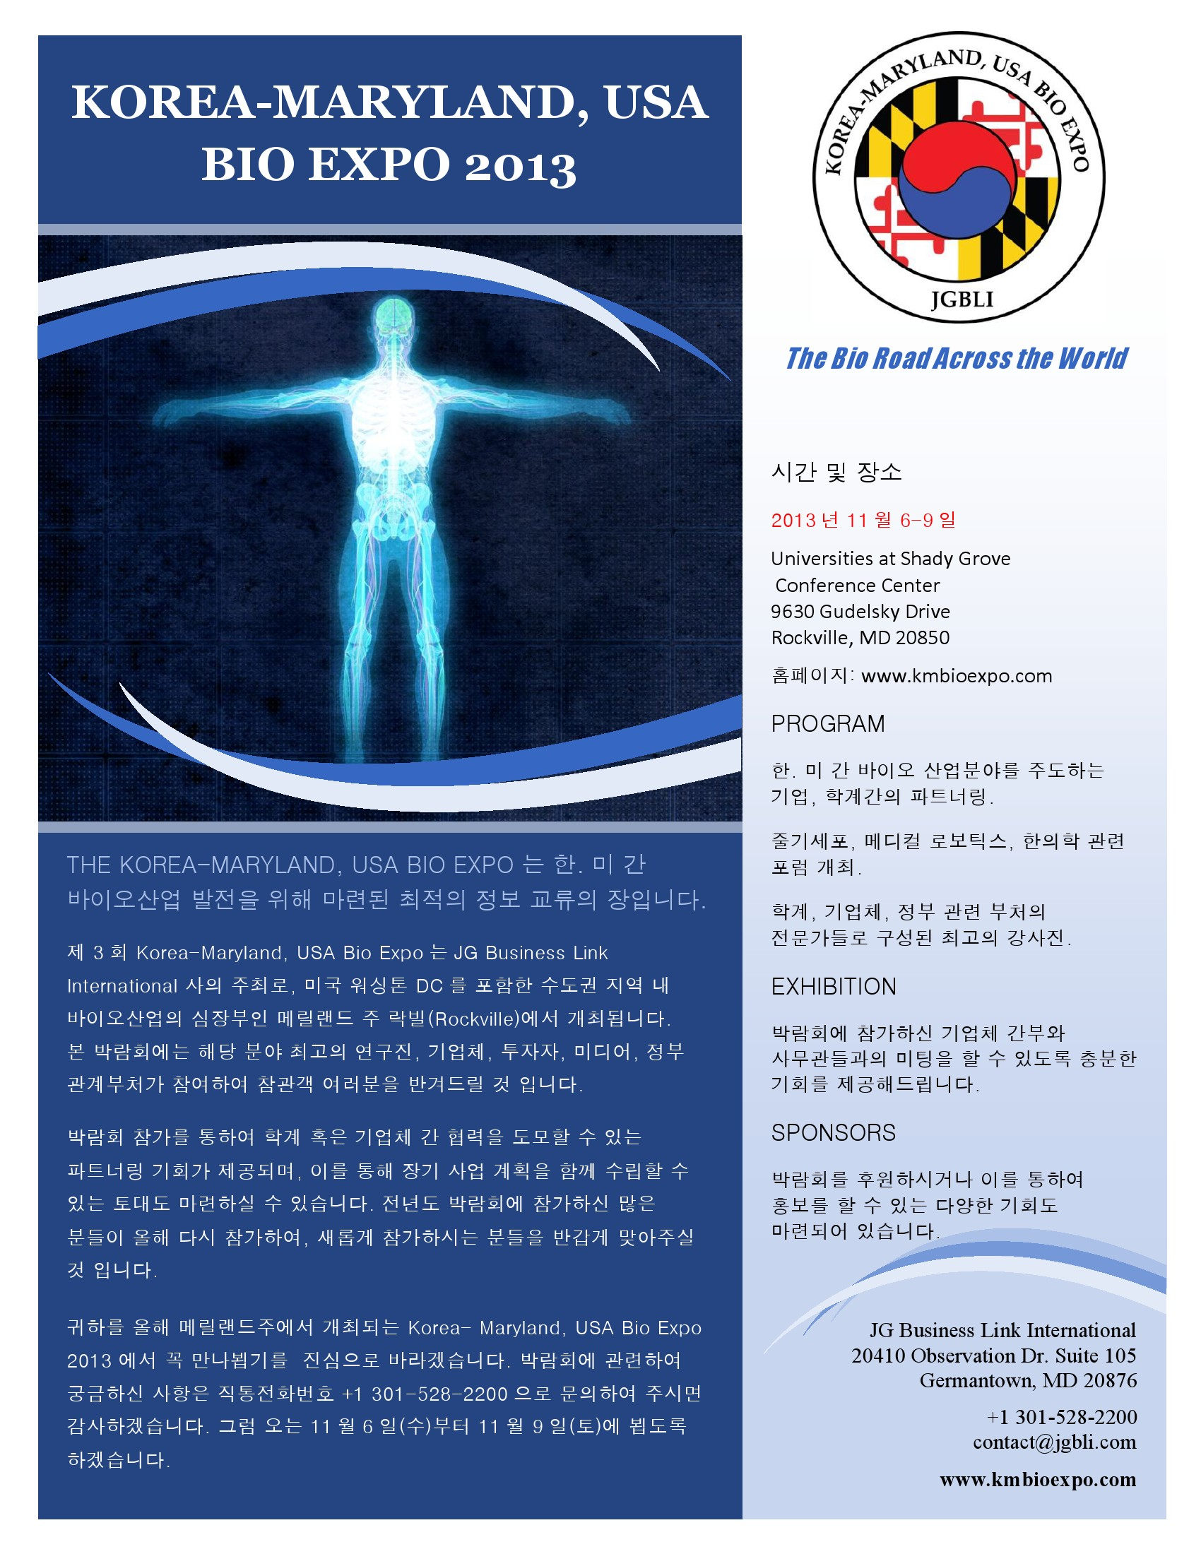

Slide 3
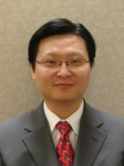

The Bio Road Across The World
Korea- Maryland, USA Bio Expo 2013
Welcome to Rockville, Maryland
Dear Attendees, Guests, and Exhibitors,
Thanks to all the past support and participation, we have been able to launch the third
Korea-Maryland, USA Bio Expo this year.
The Korea-Maryland, USA Bio Expo performs an important function in understanding
national policies and mutual exchange between Korea and the U.S. The Expo holds seminars,
business partnerships, and the mutual cooperation for the development of new pharmaceuticals,
medical robotics technology, stem-cell research, medical devices, and environmentally friendly energy research.
I would like to address a special thanks to the Embassy of the Republic of Korea and the Maryland Department
of Business and Economic Development for their support. I would like to thank again those from both Korean and
U.S. government agencies, corporations, universities and research organizations.
Now, the Korea-Maryland, USA Bio EXPO 2013 will be held from November 6th (Wed), 2013 to November 9th (Sat),
2013 at the Universities at Shady Grove Conference Center in Rockville, Maryland. We are planning special
seminars for FDA drug-development regulations, joint research, and special partnering for bio-similar
pharmaceutical development.
This year’s Korea-Maryland, USA Bio EXPO 2013 will become one of the greatest international fairs with your
participation.
Through the exhibition, I hope that the bio-industry between Korea and the U.S. will lead to further collaborated
innovations as well as opening the world markets.
Sincerely,
Wonro Lee
President & CEO
Korea-Maryland, USA Bio Expo
The Bio Road Across the World

Slide 4
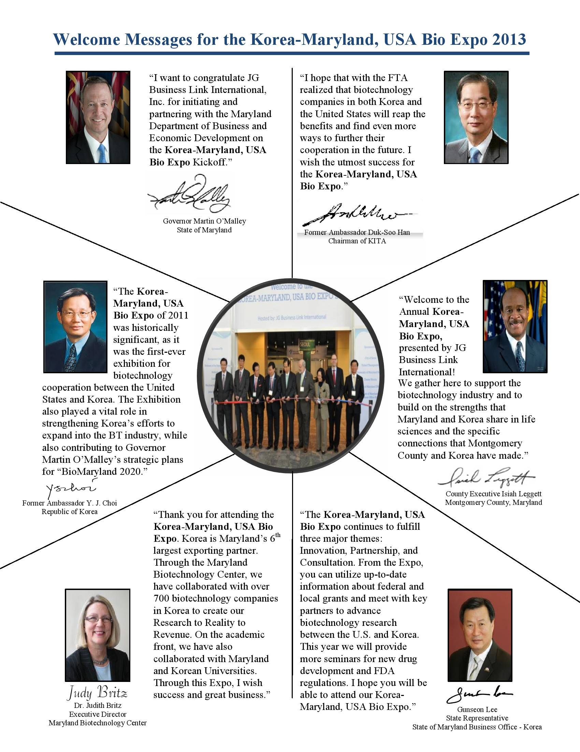

Slide 5
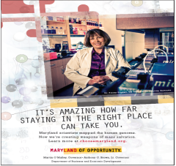











The Bio Road Across The World
Sponsors for the Korea-Maryland, USA Bio Expo 2013
www.koreabio.org
www.choosemaryland.org
www.mcc.jhu.edu
www.marylandbiocenter.org
www.umbiopark.com
www.jgbli.com
www.sombok.org
www.montgomerycountymd.gov
www.wusa9.com
www.amarexcro.com
www.koreadaily.com
Contact Information
Tel: +1 301-916-7210 Fax: +1 301-916-7212
Address: 20410 Observation Dr. Suite 105, Germantown, MD 20876 USA
E-mail: contact@jgbli.com Homepage: www.kmbioexpo.com

Slide 6
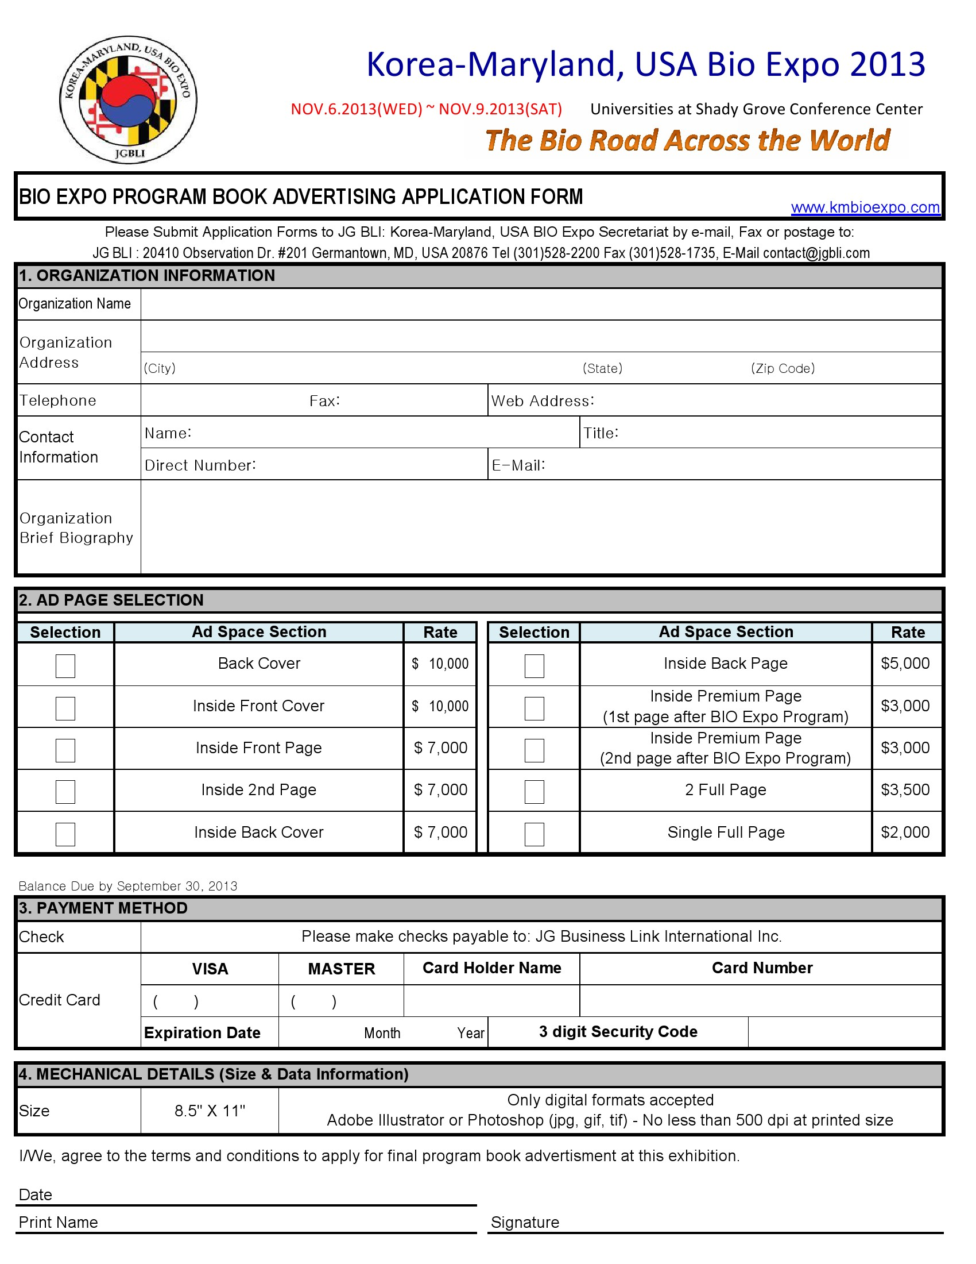

Slide 7
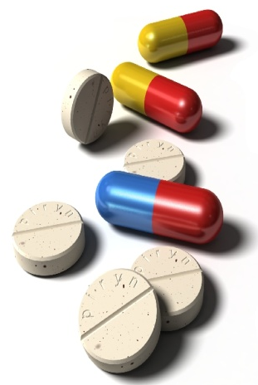
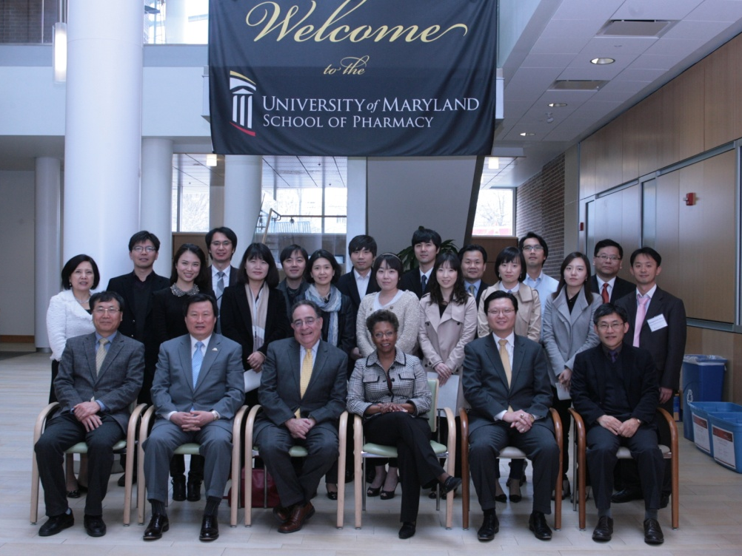
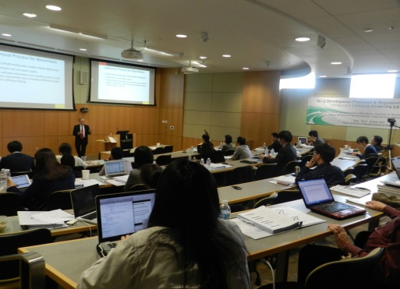
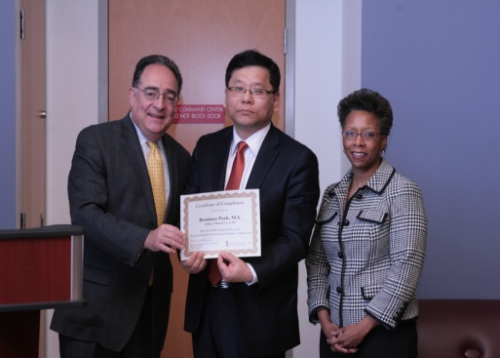
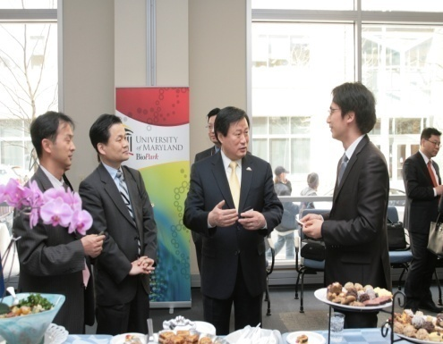
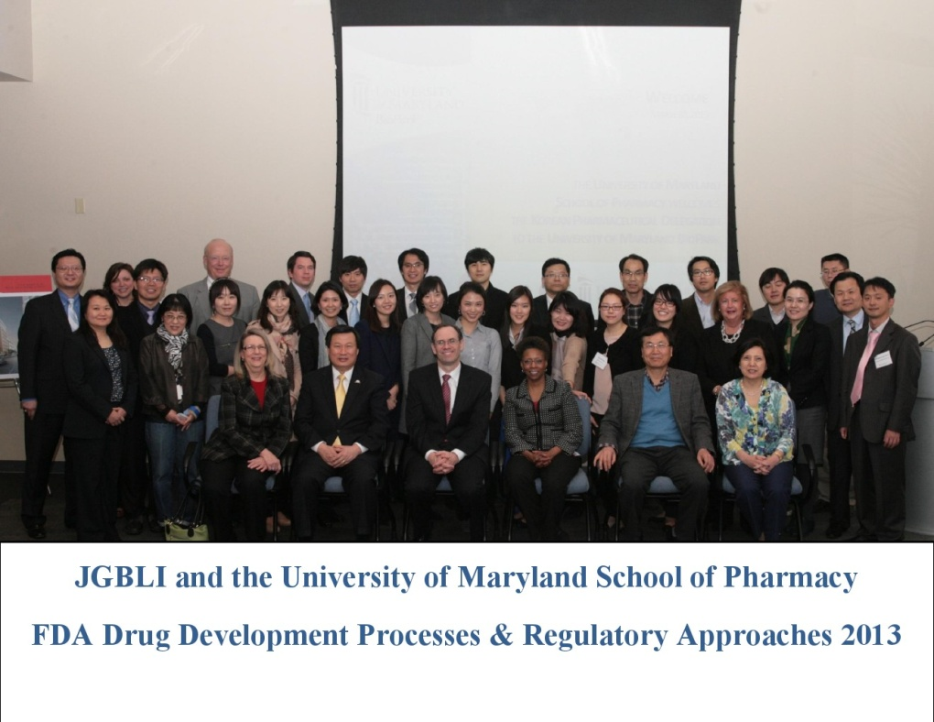
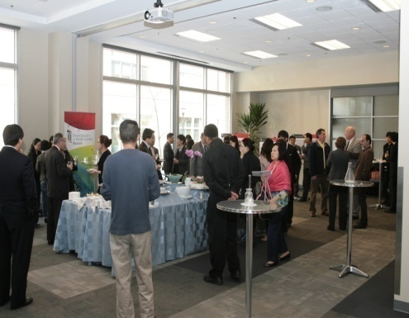
Drug Development Processes & Regulatory Approaches
신약개발 과정 및 규제적 접근을 위한 최고의 강사진 이 구성된 세미나 개최
Date: November 6th – 9th , 2013
Venue: Universities at Shady Grove Conference Center
9630 Gudelsky Dr, Rockville, MD 20850

Slide 8
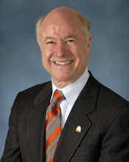
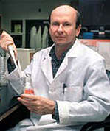
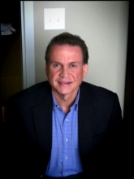
Drug Development Processes & Regulatory Approaches
신약개발 과정 및 규제적 접근을 위한 최고의 강사진 이 구성된 세미나 개최
Date: November 6th – 9th , 2013
Venue: Universities at Shady Grove Conference Center
9630 Gudelsky Dr, Rockville, MD 20850
Session Key Speakers
Francis B. Palumbo, J.D., Ph. D.
Academic Title: Executive Director & Professor
Education: The Medical University of South Carolina- B.S. Pharmacy
The University of Mississippi- M.S. and Ph.D. Health Care Administration
The University of Baltimore Law Center- J.D.
Dr. Curt I. Civin, M.D.
University of Maryland School of Medicine
Associate Dean for Research,
Director of the Center for Stem Cell Biology & Regenerative Medicine,
and Professor of Pediatrics
Dr. Howard E. Katz, Ph.D.
Johns Hopkins University Whiting School of Engineering
Department of Chemistry, Chair
Material Science & Engineering, Professor
Education: Massachusetts Institute of Technology – B.S. Chemistry & B.S. Humanities and Science
University of California, Los Angeles – Ph.D. Organic Chemistry
Russell T. Hill, Ph.D.
Professor and Interim Director, IMET (Institute of Marine and Environmental Technology University of Maryland Center for Environmental Science)
Education: 1978 Univ. of Natal, Durban, South Africa(Cellular Biol/Ecological Biol) B.Sc.
1979 Univ. of Natal, Durban, South Africa Microbiology/Plant Physiol B.Sc.(Hons)
1988 Univ. of Cape Town, South Africa Microbiology Ph.D.
1989/91 Univ. Maryland Biotechnol. Inst Molecular Microbial Ecology Postdoc
Jackson Snyder, M.D., J.D., M.P.H., M.F.S., Ph.D.
Cato Research, Asst. Managing Director, Clinical Research Physician I
Education: 1987 Ph.D., Pharmacology and Toxicology Medical College of Virginia Richmond, Virginia
1983 Master of Forensic Science (M.F.S.) GeorgeWashingtonUniversity Washington, D.C.
1982 Master of Public Health (M.P.H.) JohnsHopkinsUniversity Baltimore, Maryland
1979 Doctor of Jurisprudence (J.D.) GeorgetownUniversity Washington, D.C.
1975 M.D. Northwestern University Chicago, Illinois
1973 B.S., Chemistry and Medicine Northwestern University Evanston, Illinois
Brian M Berman, M.D.
Academic Title: Professor
Primary Appointment: Family & Community Medicine
Secondary Appointments: Family & Community Medicine
Education: Medical Degree Royal College of Surgeons, Dubin, Ireland

Slide 9
Drug Development Processes & Regulatory Approaches
신약개발 과정 및 규제적 접근을 위한 최고의 강사진 이 구성된 세미나 개최
Date: November 6th – 9th , 2013
Venue: Universities at Shady Grove Conference Center
9630 Gudelsky Dr, Rockville, MD 20850
Health and Life Science Commercialization
Session 1. Current US FDA Biosimilar Draft Guidances and Outline
This topic will discuss current draft guidances issued by the US FDA on biosimilars and explanation of the documents.
Session 2. FDA Regulation Trends for Pharmaceutical Development
Learn about current guidelines and changes affecting pharmaceutical development.
Session 3. US FDA Medical Device Regulations and Approval Process
This topic will discuss the process and approval methods of medical devices with the US FDA for PMA and 510K development.
Session 4. Dietary Supplement and Health Food Regulation and Approval Process
This topic will discuss the entry and approval process for dietary supplements and health food through the FDA.
Session 5. Stem Cells & Regenerative Medicine
Discussion of developing technologies in regenerative medicine from the University of Maryland Stem Cell Biology & Regenerative Medicine Center.
Session 6. Technology Transfer
Learn about current technologies from the University of Maryland and Johns Hopkins University that can currently be out-licensed for development
Session 7. Business Partnership
Discussion forum with current companies looking for collaboration and investment possibilities for future technology development.
Session 8. Commercialization Services
Learn about next step processes regarding the current discussion topics and how to further advance your current technology

Slide 10
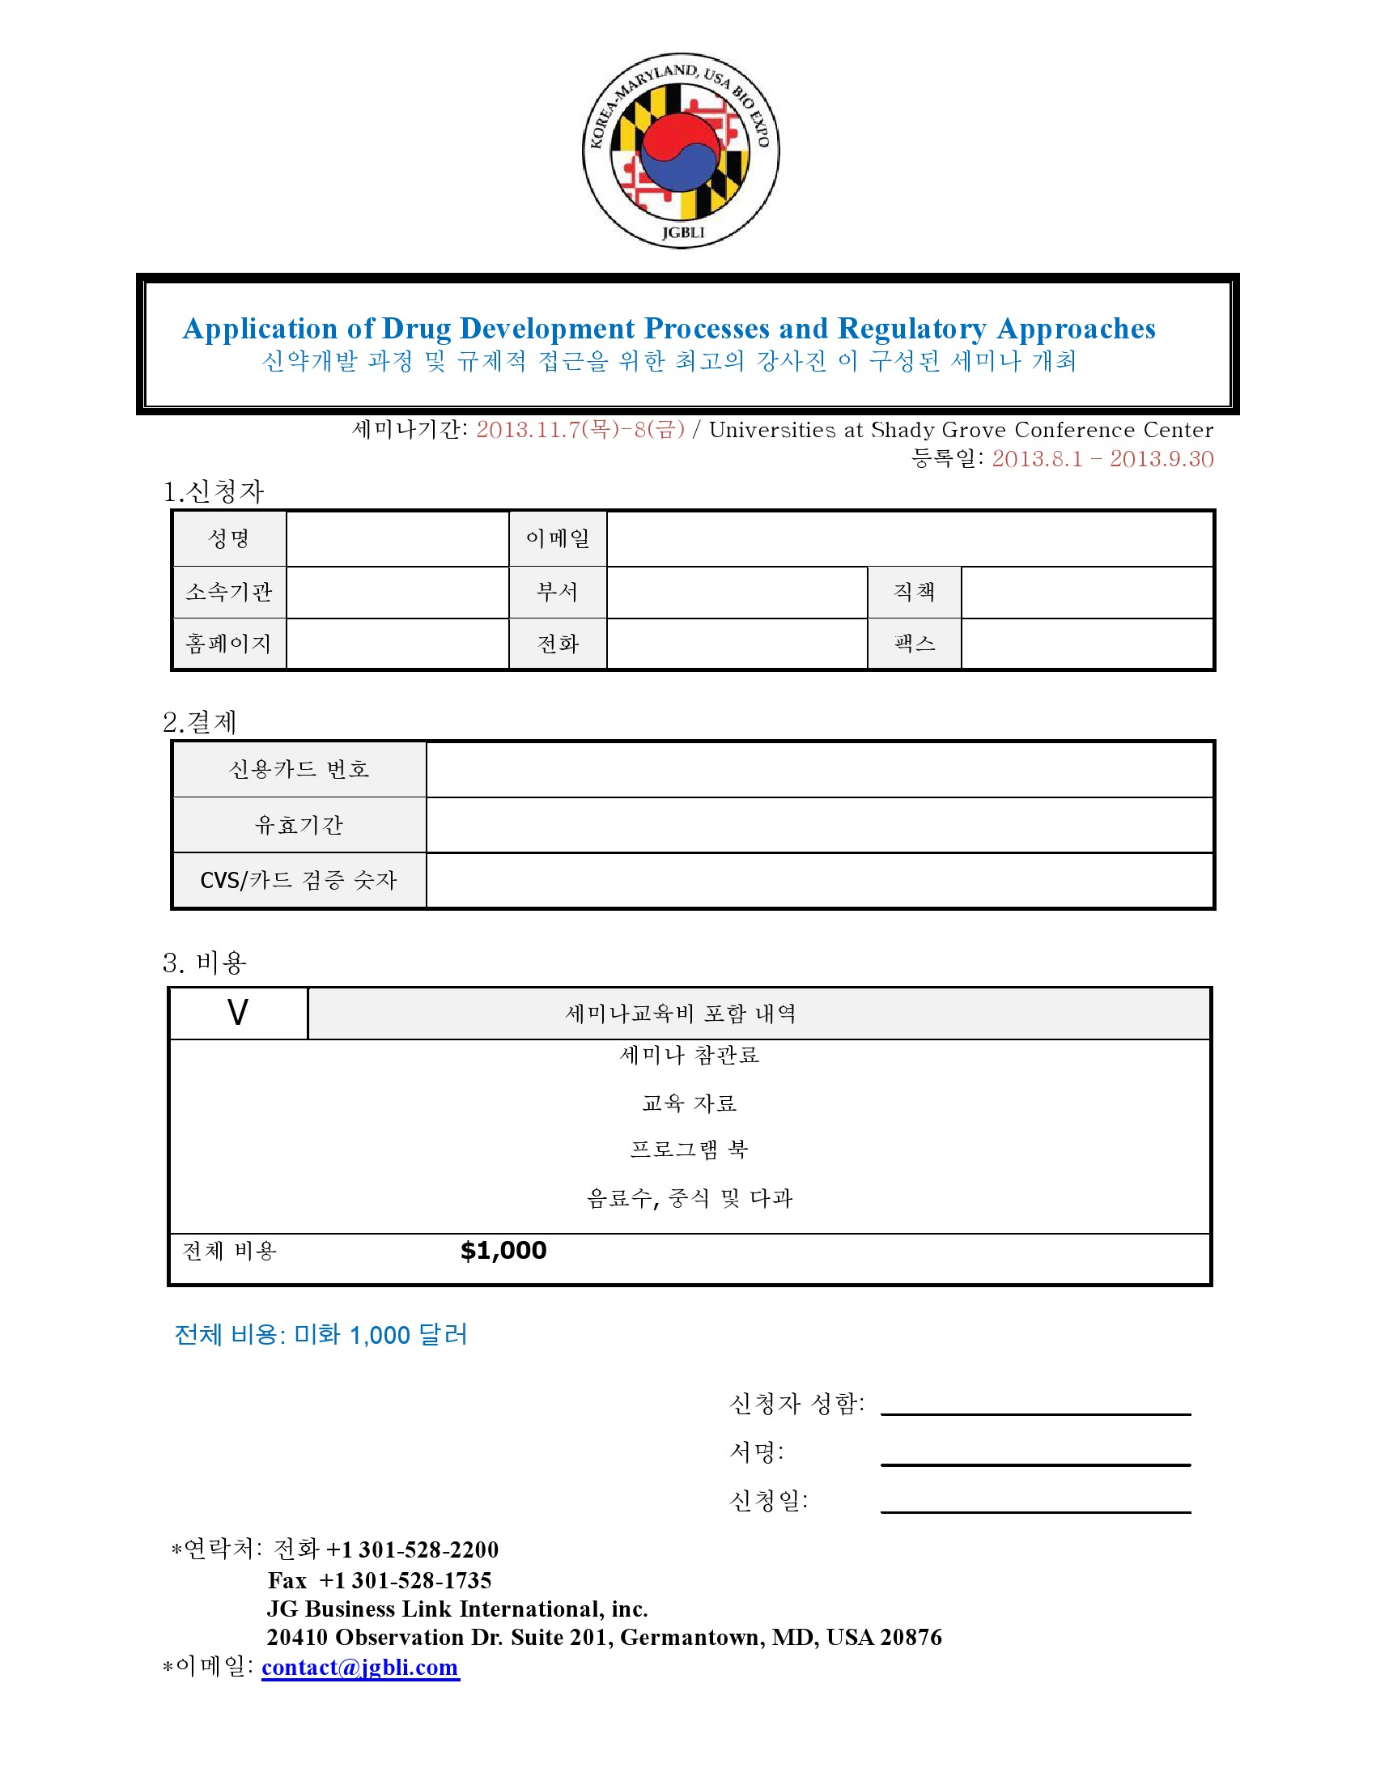

Slide 11
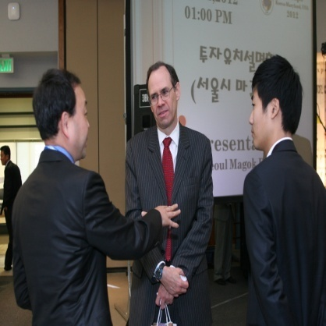
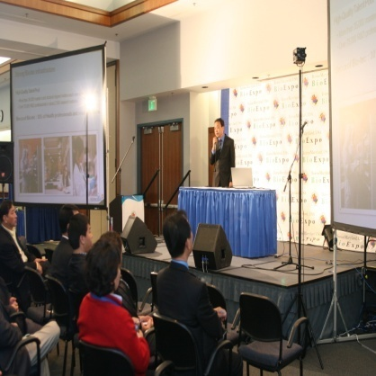
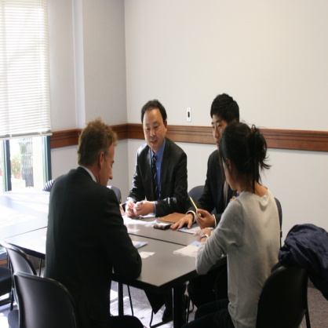
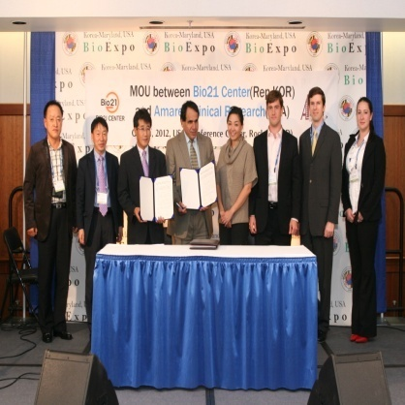
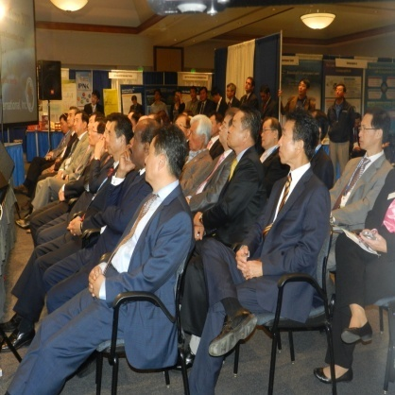
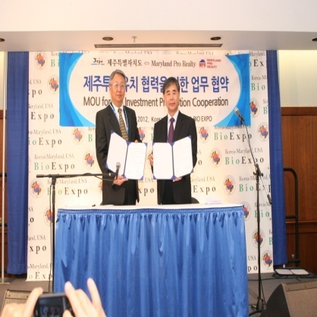
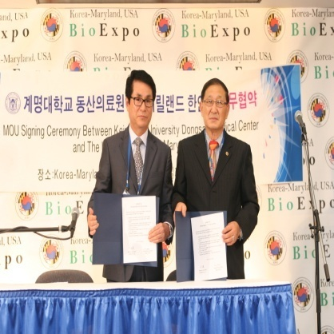
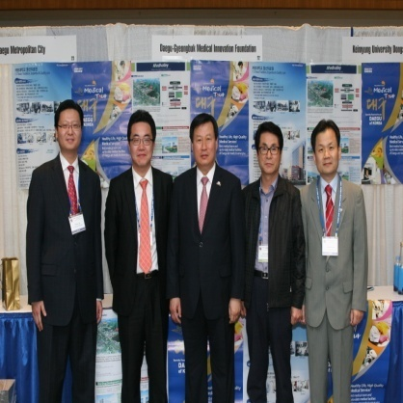
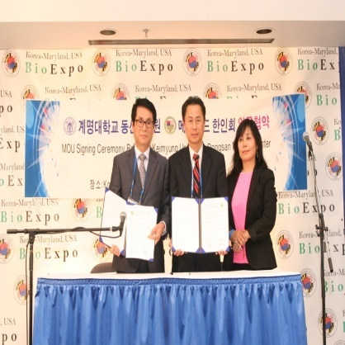
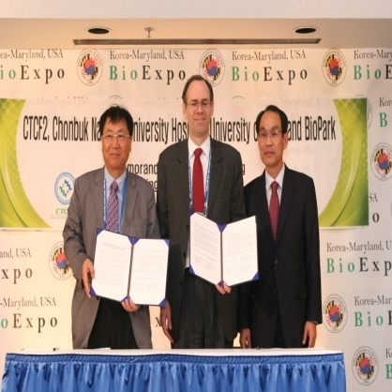
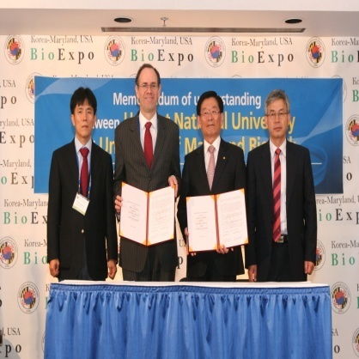
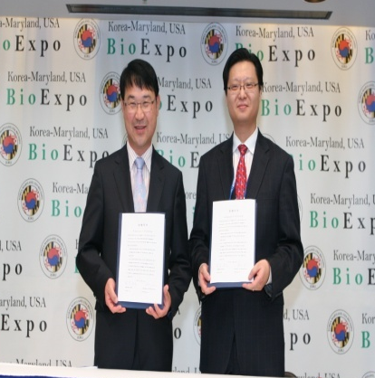
The 3rd Annual Korea-Maryland, USA Bio Expo 2013
참가하셔서 성공적인 투자 설명회를 개최 하십시요
Contact Information
Tel: +1 301-916-7210 Fax: +1 301-916-7212
Address: 20410 Observation Dr. Suite 105, Germantown, MD 20876 USA
E-mail: contact@jgbli.com Homepage: www.kmbioexpo.com

Slide 12
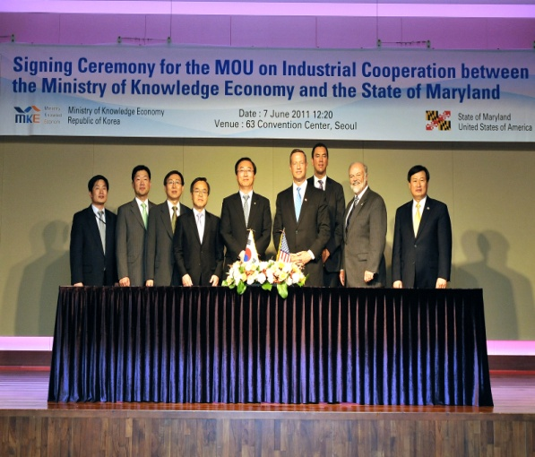
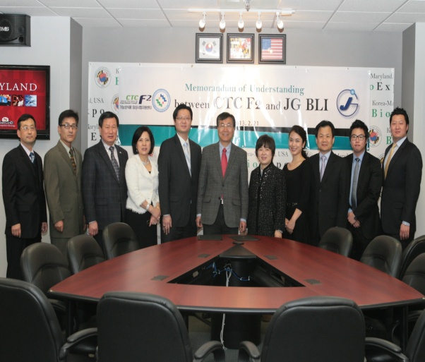
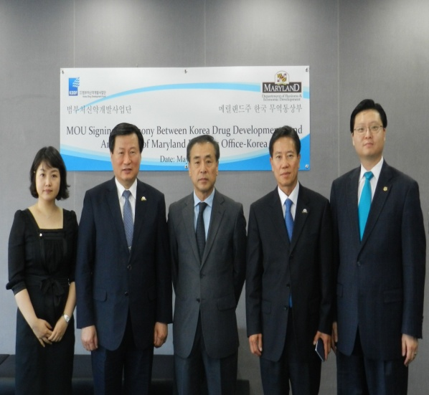
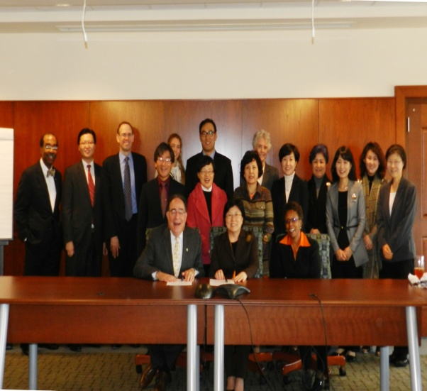
The 3rd Annual Korea-Maryland, USA Bio Expo 2013
참가하셔서 성공적인 Business Partner를 만나십시요
지식경제부와 메릴랜드주의 신성장동력
인 바이오산업과 최첨단 과학분야의
공동 개발 협력 및 발전을 위한 파트너
협약을 함.
전북대 병원 임상센터와 메릴랜드주
바이오파크 그리고 JGBLI사 의 파트너
협력 체결 후 한미간 의 신약개발과
기능성 식품 검사를 위한 GLP 연구소,
임상센터를 메릴랜드주에 설립하였음.
정부
기업
한국 범부처 신약개발사업단과 MD주
한국 무역 통상부와 한미간 신약개발
협력을 위한 공동 연구, 투자, M&A등
의 교류와 FDA 규제 이해 및 최신정보
공유를 위한 세미나 개최의 협약체결함.
이화여대 의료원과 메릴랜드대 병원간의
상호 의료발전과 줄기세포 공동개발
및 인턴교류. 학술발표 세미나를 위한
파트너 협약을 함.
사업
대학
Contact Information
Tel: +1 301-916-7210 Fax: +1 301-916-7212
Address: 20410 Observation Dr. Suite 105, Germantown, MD 20876 USA
E-mail: contact@jgbli.com Homepage: www.kmbioexpo.com

Slide 13

Korea-Maryland, USA Bio Expo 2012 Report
Oct.9-12th, 2012 / USG Conference Center, MD, USA www.kmbioexpo.com
전시 참가 및 참관기업
Korea-Maryland, USA Bio Expo 2012에 참여 및 참관한 기업은 아래와 같다 (총 196개 / 알파벳 순)
A.M. BIO MAT, Alpha Genics, Amarex Clinical Research, American Nigerian International Chamber of Commerce, Asian Atlanta Newspaper, Asian Tea Association, Atomy Cosmetics, Baltimore Development Corporation, Bio 21 Center, BioKorea (KHIDI), BioCentury, BioHealth Innovation, Biomedical IT Convergence Center, Cangene BioPharma, Capital Luggage Inc. , Cato Research, Center for Environmental Science, Central Pennsylvania Korean Association, Chaga International, Cheonjong Wild Ginseng , Chonbuk National University Hospital ,Chungbuk Government , Clinical Trial Center for Functional Food , Clonexpress, Inc ,Cosmocyte, Countrywide Insurance, Montgomery County, Covenant Therapeutics, LLC, Daegu Metropolitan City, Dague-Gyeongbuk Medical Innovation Foundation(DGMIF), Dong Bang Acupuncture Clinic & Herbs, Dongjin Pharmacy, DR HITEC, EHL Bio Corporation, Embassy of the Republic of Korea in the United States of America, Federal Government, FLUXOME KO Discovery, Baltimore Bioworks, Fuzbien Technology Institute(FTI), Garfield and Company , George Mason University, George Washington University, George Washington University Medical School, GlobalChildren Foundation, Gohyaung Chamot , GPCW, GRD Group ,Great Washington Chamber of Commerce, Gyeogsangbuk-do,Gyeongsangbuk-do Provincial Gov't., Korea, Investment Promotion Center, Hahn Moo-Sook House, Hamp Korea, Han & Associates,PLLC, Hanbat National University, Hankuk University of Foreign Studies, Heajin Jung Law Firm LLc ,Health Research International , Hongcheon Institute of Medicinal Herb(HIMH), Howard University ,HP Park & Associate LLC, i Talk BB , ICAS, Ildong Pharmaceutical Company, Im Quest BioSciences, Inje University , College of Medicine, Innotive, Innova Hospital, INSANGA Inc. Institute of Marine and Environmental Technology, Institute of Sunchang Fermented Soybean Products Integrated Healthcare, Jang Soo Stone Bed, Jangsaeng Doraji, JC Mission , Jeju Bio Energy, Jeju Free International City Development Center, Jeju Special Self-Governing Provincial Government, Jeollanam-do Provincial Government New York Trade Office (USA), JG BLI, JJN Construction Inc., Johns Hopkins Hospitals ,JoongAng Ilbo, JRS Holdings, Jyoon Enterprises, JY Group Inc., KAMA of Great Washington, KCRN Research, LLC, Keimyung Univ.,Dongsan Medical Center,Keimyung University , KHE Bio, KHIDI (Health Technology Transfer Center), King Tiger Material Arts, Korean Women's Essayists Club of Washington, Konkuk Nokyong Development Institute, Korea Daily, Korea Kanghwa Ginseng, Korea OneTelevision, Korea Southeast US Chamber of Commerce , Korea Trade-Investment Promotion Agency(KOTRA), Korean American Auto Association, Korean American Chamber of Commerce of Atlanta, Korean American Chamber of Commerce of Greater Washington, Korean American Dri Cleaner Association Inc., Korean American Foundation-Washington, KoreanAmerican Peace Alliance, Korean Americans Association of Maryland, Korean Baptist College, Korean Church of Rockville, Korean Veterance Association, Korean War Veterans Association of Washington, Korean-American Chamber of Commerce, USA KORUS Network Inc, Kotra KWVA/Partisans A.U. of National Chapter, KOWIN, League of Korean Americans (LOKA), Library of Congress, USA, Long and Foster Real Estate, Maryland Biotechnology Center, Maryland Church Association, Maryland Information Technology Center , Maryland Pro realty, Maxcyte, Medi City Daegu, Media #, Medical Social Enterprise, Mega Realty and InvestmentInc. Metro Atlanta korean American Chamber of Commerce, Michell Kim Realtor, Ministry of Knowledge Economy, Montgomery County Council, Montgomery County Department of Economic Development, National Institute of Standards of Technology(NIST), N-Biotek ,Neodin, New Power of Korea, Newstar Realty, Nu Skin, Oriental Art Collection, Osong Medical Innovation Foundation , Paragon Bioservices, Park's Gourmet Inc., Penn Arts & Sciences (University of Pennsylvania), Pure Natural Korea Co., Ltd.(PNK) Purifines Natural Care Pyunkang Herbs Rafagen Samsung SDS Seoul City Magok District, Shinan Growth Co. Ltd, Silverspring Senior Assocation, SNBL Clinical Pharmacology Center,Inc , Society of Physician Entrepreneurs ,State of Maryland Business Office-Korea ,State of Maryland Department of Business & Economic Development ,Sterne Kessler Goldstein Fox, Stra University, Stroya UN, Sun LED ,Sunchang County, The Bank of Korea, The Federation of Korean Associations U.S.A. ,The George Washington University School of Business, The Korea Daily, The korean Society of Maryland, The National Unification Advisory Council Republic of Korea-Atlanta Chapter, Tiger Judo Center, TJ Car Wash, TouChiU, U.S. Food and Drug Administration(US FDA), UMC INC, Unhwa Bio Corporation, Univ. of MD, (Institute for Bioscience and Biotechnology Research(IBBR), University of Maryland BioPark, University of Maryland School of Medicine, University of Maryland School of Pharmacy, University of Maryland, The Founding Camous US Business Solution Inc., US GTF, Virginia State of Commerce and Trade Wagner Law, LLC , Washington Coalition For Comfort Women Issues, Washington Youth Foundation, Weichert Realtors, WKTV, Woongjin Coway, Woori Care, Woo's Construction, Word of God Church, World Bank World Best Inc. WUSA 9 Yeonsei University Yoo Networks, Inc. Youngwon Trading Inc.

Slide 14
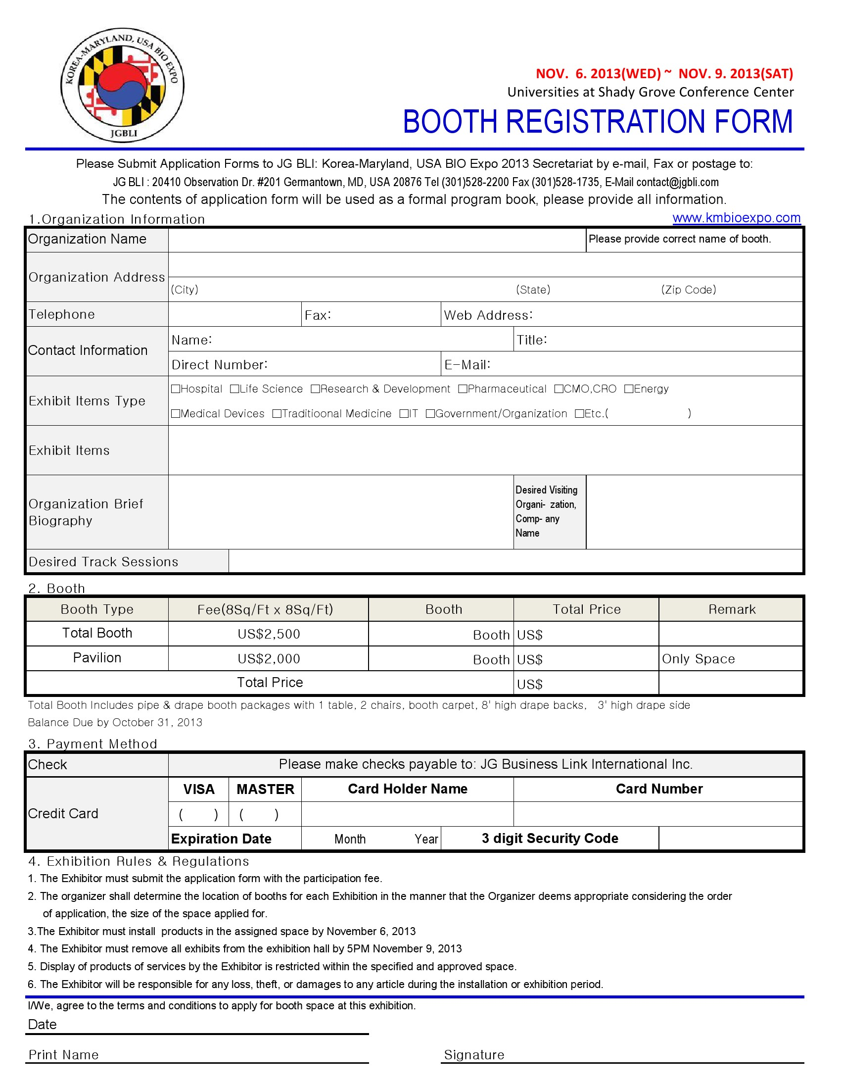

Slide 15
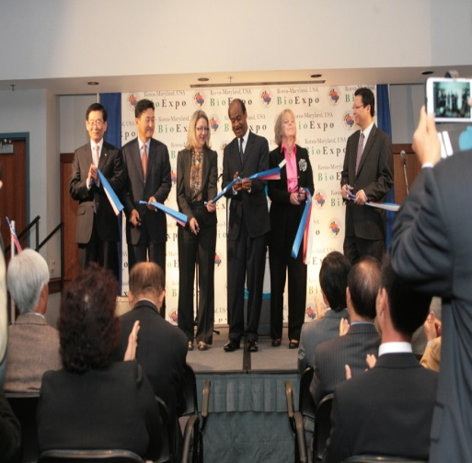
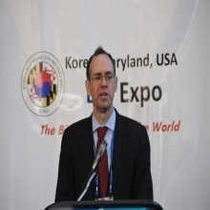
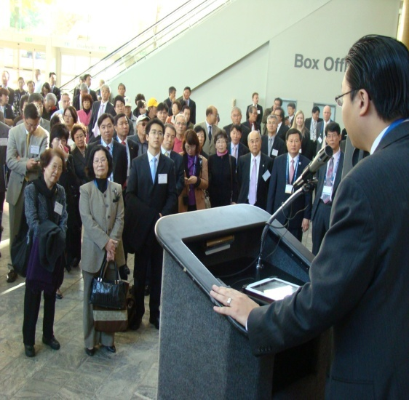
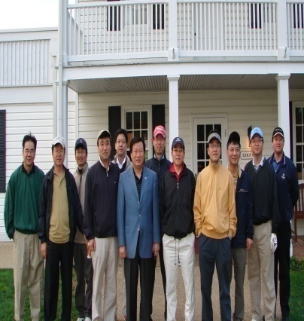
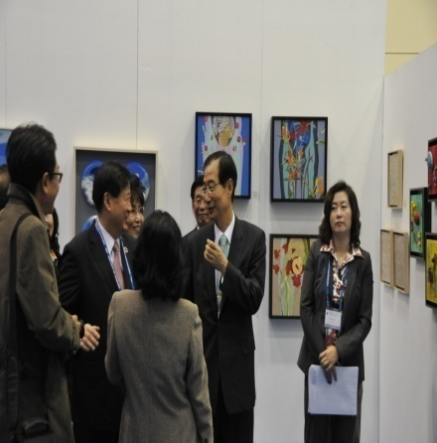
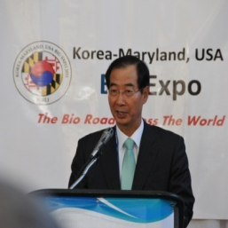
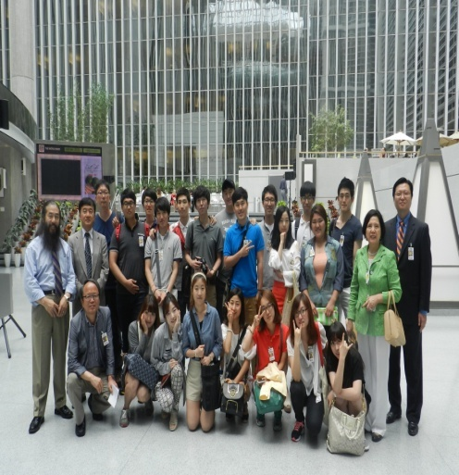
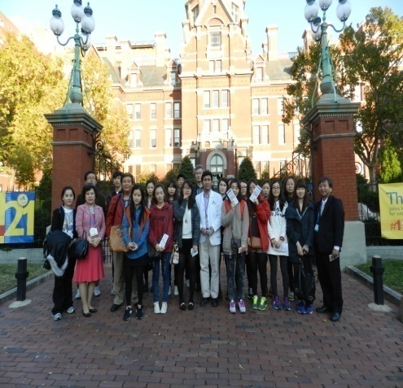
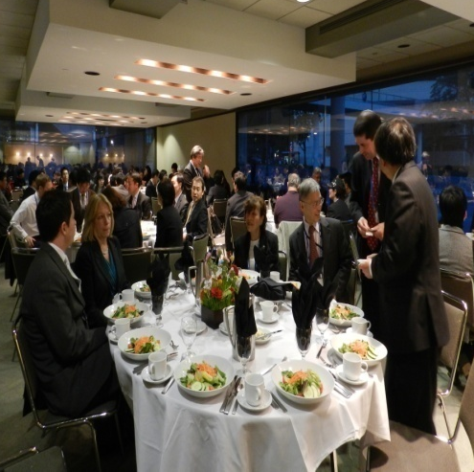
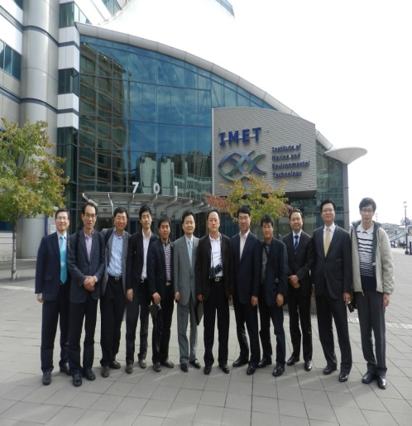
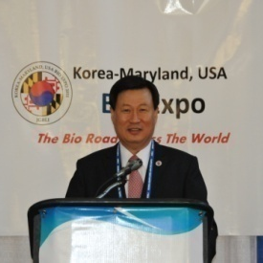
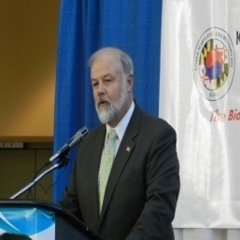
Korea- Maryland, USA Bio Expo 2013 Events
Tape Cutting
&
Start of Expo
Opening Ceremony
Bio Golf
Bio Art
WorldBank
Tour
JHU Medical School
IMET Partner
Meeting
Welcome Dinner

Slide 16
KOREA-MARYLAND, USA BIO EXPO 2013
박람회 행사 안내를 드립니다
행사일정: 2013.11.6(수)-2013.11.9(토)
행사장소: Universities at Shady Grove Conference Center
  9630 Gudelsky Drive
  Rockville, MD 20850
홈페이지: www.kmbioexpo.com
호텔안내
Hilton Garden Inn
14975 Shady Grove Rd Rockville, MD 20850
(240) 507-1800 www.hiltongardeninn.com
Crowne Plaza
3 Research Court, Rockville, MD 20850
(301) 840-0200 www.cprockville.com
Comfort Inn Shady Grove
16216 Frederick Road, Gaithersburg, MD 20877
(301) 330-0023 www.choicehotels.com
Chase Suite Hotel
1380 Piccard Drive, Rockville, MD 20850
(240) 238-0901 www.chasehotelrockville.com
Residence Inn by Marriott
9721 Washingtonian Blvd, Gaithersburg, MD 20878
(301) 590-3003 www.residenceinngaithersburg.com
Double Tree Hotel
1750 Rockville Pike, Rockville MD 20852
(301)468-1100 www.doubletree1.hilton.com
Springhill Suites by Marriott
9715 Washingtonian Boulevard, Gaithersburg,
MD 20878, (301) 987-0900 www.marriott.com

Slide 17
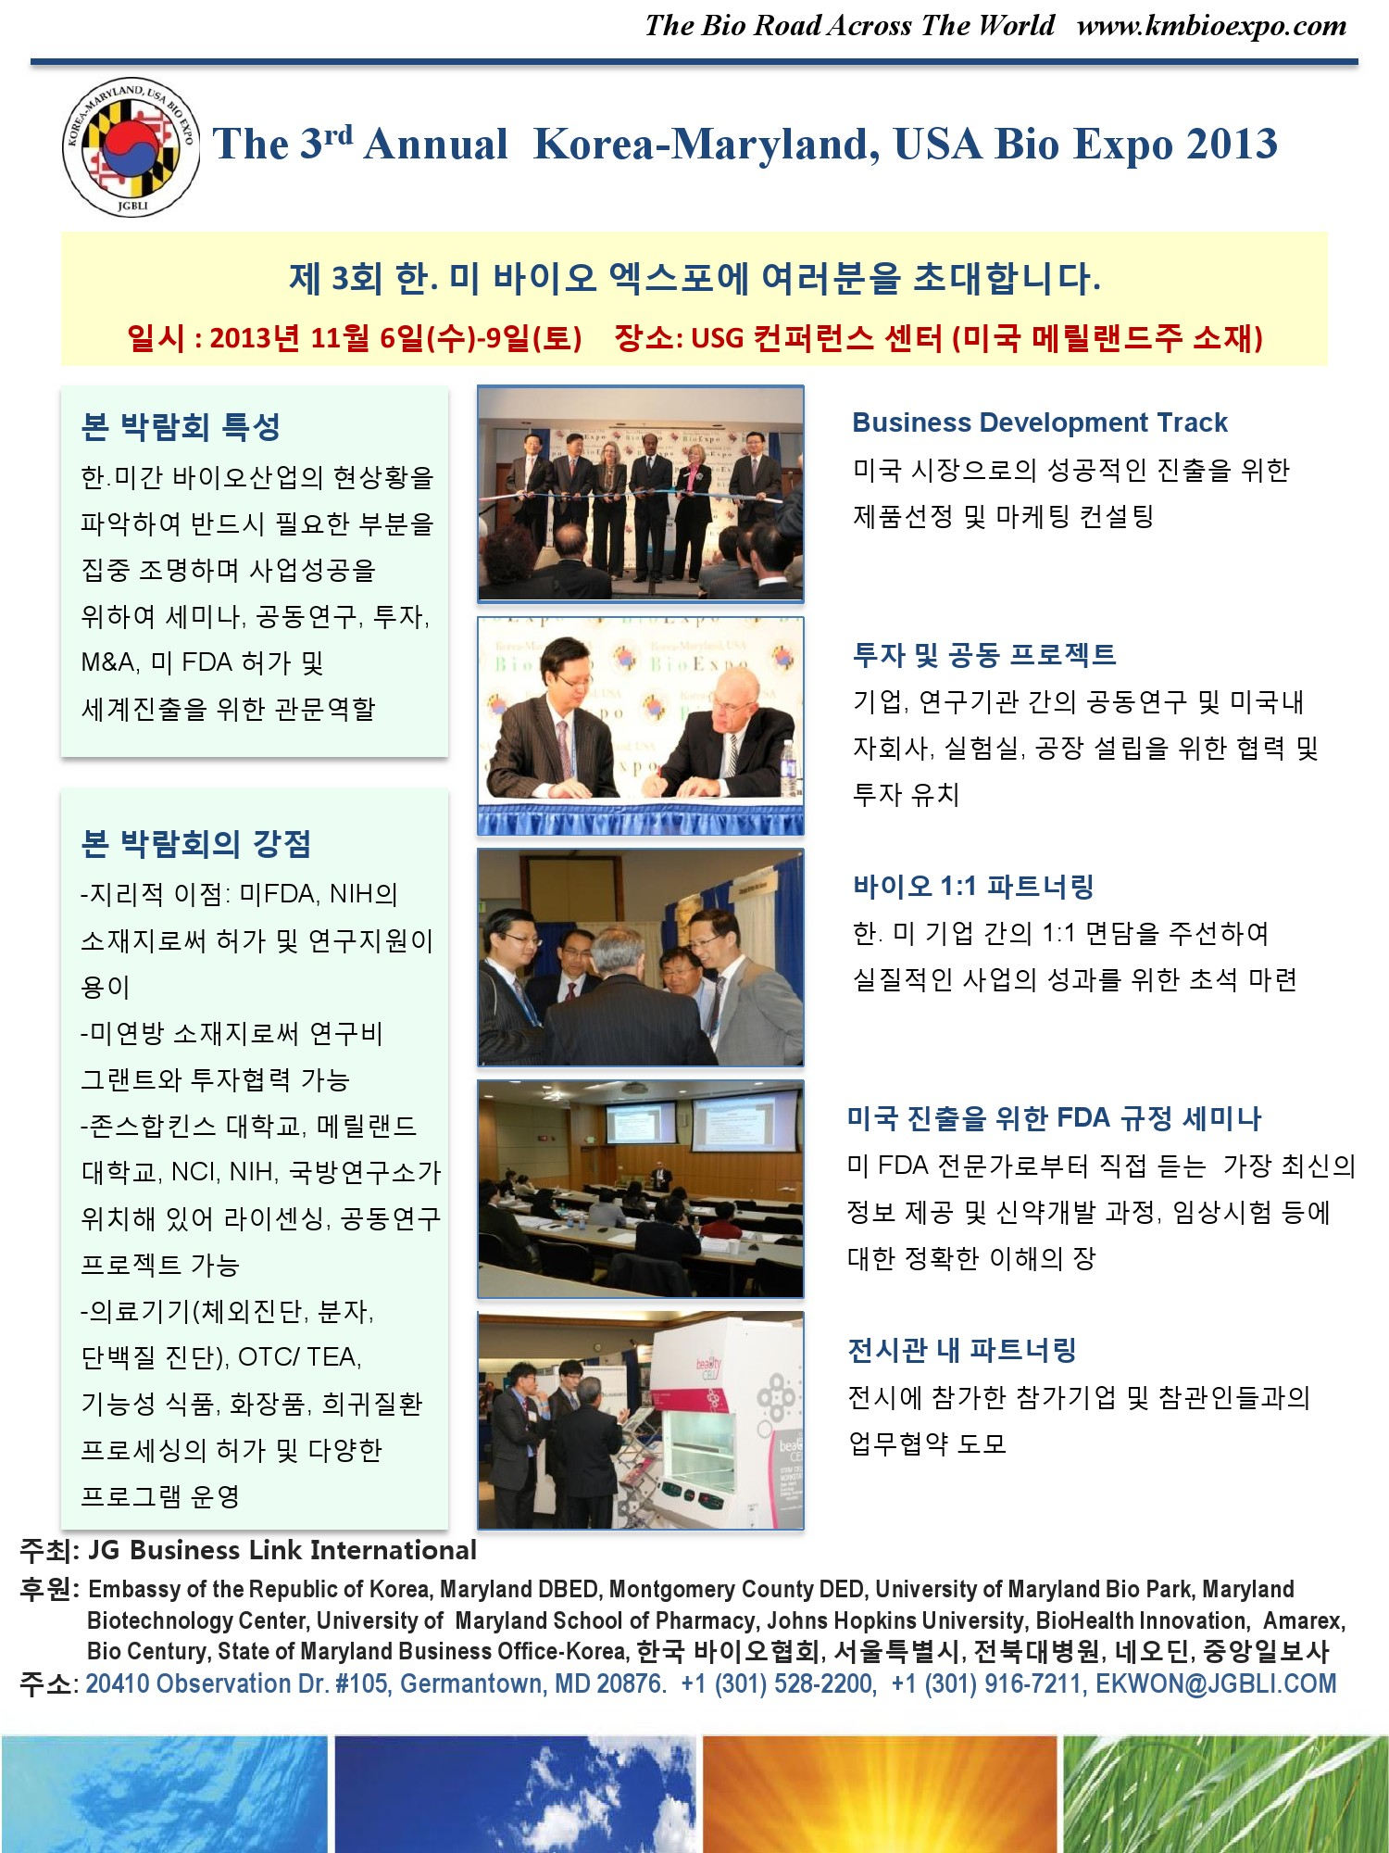

Slide 18
The Bio Road Across The World
Thank you for coming this year and
We are looking forward to see you again at
Korea-Maryland, USA
Bio Expo 2013
Mark your calendar!
Nov. 6(Wed)-9(Sat), 2013
Universities at Shady Grove Conference Center
Rockville, Maryland
Contact Information
Tel: +1 301-528-2200
Fax: +1 301-528-1735
Address: 20410 Observation Dr. Suite 201,
Germantown, MD 20876 USA
E-mail: contact@jgbli.com
Homepage: www.kmbioexpo.com
The Bio Road Across The World

